Slide 1
Course Title: Engineering Chemistry-1
Course Code: CHE109
(Chapter 1)
Dr. Joyanta Kumar Saha
Associate Professor
Department of Chemistry
Jagannath University

Slide 2
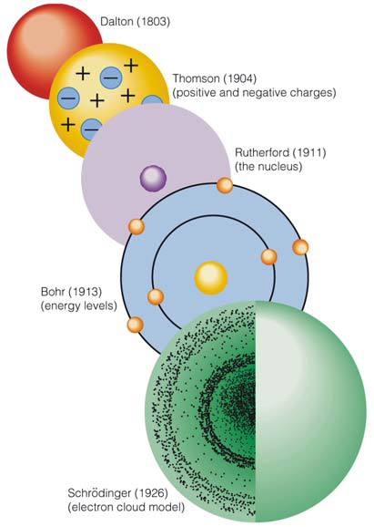
Structure of Atom
John Dalton (1805) considered that all matter was composed of small particles called atoms. He visualized the atom as a hard solid individual particle incapable of subdivision. At the end of the nineteenth century, it was shown that atom is made of still smaller particles. These subatomic particles are called the fundamental particles.
Three important subatomic particles are:
a) Proton b) Neutron c) Electron

Slide 3
ELECTRON (J.J. Thomson): An electron is a subatomic particle which bears charge – 1.60 × 10⁻¹⁹ coulomb and has mass 9.1 × 10⁻²⁸ g.
A particle which bears one unit negative charge and mass 1/1835th of a hydrogen atom.
PROTONS (J.J. Thomson): A proton is defined as a subatomic particle which has a mass of 1 amu and charge + 1 elementary charge unit.
A proton is a subatomic particle which has one unit mass and one unit positive charge.
H ⎯⎯→ H⁺ + e–
proton
NEUTRONS: A neutron is a subatomic particle which has a mass almost equal to that of a proton and has no charge.

Slide 4
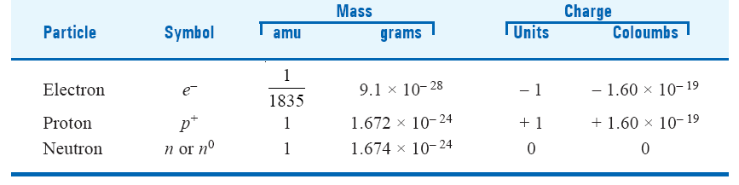

Slide 5
Other Subatomic Particles: a) mesons, b) positrons, c) neutrinos and d) antiprotons
RUTHERFORD’S ATOMIC MODEL – THE NUCLEAR ATOM: He made Alpha Particle-Scattering Experiment.
He bombarded nitrogen and other light elements by α-particles when H+ ions or protons were produced. This showed the presence of protons in atoms other than hydrogen atom.
(2) He got a clue to the presence of a positive nucleus in the atom as a result of the bombardment of thin foils of metals.
ALPHA PARTICLES: It has twice the charge of a proton and about 4 times its mass. α-Particles are also formed in the discharge tube that contains helium,
He ⎯⎯→ He²⁺ +2e−

Slide 6
According to Rutherford’s atomic model;
Atom has a tiny dense central core or the nucleus which contains practically the entire mass of the atom, leaving the rest of the atom almost empty.
The entire positive charge of the atom is located on the nucleus, while electrons were distributed in vacant space around it.
The electrons were moving in orbits or closed circular paths around the nucleus like planets around the sun.
Weakness of Rutherford Atomic Model: 1) if a charged particle accelerates around an oppositely charged particle, the former will radiate energy.
2) If an electron radiates energy, its speed will decrease and it will go into spiral motion, finally falling into the nucleus.

Slide 7


Postulates of Bohr’s Theory:
Electrons travel around the nucleus in specific permitted circular orbits and in no others.
While in these specific orbits, an electron does not radiate (or lose) energy.
(3) An electron can move from one energy level to another by quantum or photon jumps only.
(4) The angular momentum (mvr) of an electron orbiting around the nucleus is an integral multiple of Planck’s constant divided by 2π.

Slide 8
where m = mass of electron, v = velocity of the electron, r = radius of the orbit ; n = 1, 2, 3, etc., and h = Planck’s constant.
By putting the values 1, 2, 3, etc., for n, we can have the angular momentum
Thus the angular momentum is said to be quantized.
The integer n in equation can be used to designate an orbit and a corresponding energy level n is called the atom’s Principal quantum number.

Slide 9
ATOMIC NUMBER (Z): Atomic Number of an element is equal to the number of protons in the nucleus of the atom of that element. Atomic Number is often referred to as the Proton Number.
MASS NUMBER: The mass number of an atom is equal to the total number of nucleons in the nucleus of an atom. For example, the atomic mass of sodium and fluorine obtained by experiment is 22.9898 and 26.9815 amu respectively. Thus their mass numbers are 23 for sodium and 27 for fluorine.

Slide 10
Orbital: The three-dimensional region within which there is higher probability that an electron having a certain energy will be found, is called an orbital.
Quantum Numbers: Bohr designated the energy states by n = 1, 2, 3..., These states are also identified by numbers and specify the position and energy of the electron. Thus there are in all four identification numbers called quantum Numbers which fully describe an electron in an atom.
Principal Quantum Number ‘n’: This quantum number denotes the principal shell to which the electron belongs. The principal quantum number ‘n’ can have non-zero, positive, integral values n = 1, 2, 3...
There is a limited number of electrons in an atom which can have the same principal quantum number and is given by 2n², where n is the principal quantum number concerned.

Slide 11
Azimuthal Quantum number ‘l ’: The quantum number “l’’ defines the shape of the orbital occupied by the electron and the angular momentum of the electron. ‘l’ is sometimes referred to as orbital or angular quantum number.
The azimuthal quantum number l may have all integral values from 0 to n – 1, each of which refers to an Energy sublevel or Sub-shell. The total number of such possible sublevels in each principal level is numerically equal to the
principal quantum number of the level under consideration. These sublevels are symbolised by letters s, p, d, f etc.

Slide 12
Magnetic Quantum Number ‘m’: This is also called Orientation Quantum Number because it gives the orientation or distribution of the electron cloud.
For each value of the azimuthal quantum number ‘l’, the magnetic quantum number m, may assume all the integral values between + l to – l through zero i.e., + l, (+ l – l),... 0..., (– l + 1), – l.
Therefore for each value of l there will be (2l + 1) values of m_{l}. when l = 0, m = 0 and no other value.

Slide 13
For l = 1 (p orbital), the magnetic quantum number m will have three values : + 1, 0 and – 1;
These three types of p orbitals differ only in the value of magnetic quantum number and are designated as p_{x}, p_{y}, p_{z} depending upon the axis of orientation
For l = 2 (d orbital), the magnetic quantum number are five + 2, + 1, 0, – 1, – 2. Designated as d_{xy}, d_{yz}, d_{zx}, d_{x^2-y^2} , d_{z^2}.

Slide 14
Spin Quantum Number ‘s’: This quantum number has been introduced to account for the spin of electrons about their own axis.
There are two values given to s ; +1/2 and -1/2 depending upon whether the electron spins in one direction or the other.

Slide 15
List all possible values of l and m for n = 2.
When l = 0; m = 0 and l = 1; m = + 1, 0, – 1
PAULI’S Exclusion Principle: No two electrons in an atom can have the same set of four identical quantum numbers.
Even if two electrons have the same values for n, l and m, they must have different values of s.

Slide 16
Consider the second shell (n = 2),

Slide 17
The periodic table of elements, arranges the chemical elements
according to their recurring properties.
The 7 rows of the table, called periods, generally have metals on the left and nonmetals on the right.
The columns, called groups, contain elements with similar chemical behaviors. There are 18 groups according to modern periodic table.
In Lanthanide series La(57)-Lu(71) where 14 electrons successively put into 4f orbitals.
In Actinide series Ac(89)-Lr(103) where electrons goes to 5f orbitals.

Slide 18
GROUND-STATE ELECTRON CONFIGURATION OF ELEMENTS
Rule 1. Each electron shell can hold a maximum of 2n² electrons where n is the shell number.
Rule 2. These electrons are accommodated in s, p, d and f orbitals, the maximum number of electrons in each type of orbitals being determined by its electron-holding capacity (for s = 2, p = 6, d = 10 and f = 14).
Rule 3. In the ground state of an atom, the electrons tend to occupy the available orbitals in the increasing order of energies, the orbitals of lower energy being filled first. This is called ‘building up principle’ or Aufbau Principle.

Slide 19
GROUND-STATE ELECTRON CONFIGURATION OF ELEMENTS
The energy of the orbital is determined by n+l rule.
4s and 3d?? 4p and 5s??
When two orbitals have same (n + l) value, the orbital with lower value of n has lower energy.
Rule 4. Any orbital may have one or two electrons at the most.
Rule 5. When several orbitals of equal energy (degenerate orbitals) are available, electrons prefer to occupy separate orbitals rather than getting paired in the same orbital. (Hund’s rule)

Slide 20
Hund’s rule: When a set of orbitals of equal energy is being filled with electrons, the electrons distribute themselves in these orbitals so as to retain parallel spin as far as possible. C(6) electronic configuration; 1s²2s²2p_{x}¹p_{y}¹p_{z}

Slide 21
GROUND STATE ELECTRON CONFIGURATION OF ELEMENTS
1 H 1s¹
2 He 1s²
6 C 1s² 2s²2p²
7 N 1s² 2s²2p³
8 O 1s² 2s²2p⁴
11 Na 1s² 2s²2p⁶ 3s¹
16 S 1s² 2s²2p⁶ 3s²3p⁴
18 Ar 1s² 2s²2p⁶ 3s²3p⁶
28 Ni 1s² 2s²2p⁶ 3s² 3p⁶ 4s²3d⁸
Cu 1s² 2s²2p⁶ 3s² 3p⁶ 4s¹3d¹⁰
42 Mo 1s² 2s²2p⁶ 3s² 3p⁶ 3d¹⁰ 4s² 4p⁶5s¹4d⁵
full filled, Cu, Pd, Ag, Pt, Au
half filled

Slide 22
IONISATION ENERGY: The ionization energy (IE) of an element is defined as the energy needed to remove a single electron from an atom of the element in the gaseous state. That is,
M(g ) + I E ⎯⎯→ M+ ( g ) + e−
The First ionization energy (IE1), is the energy needed to remove the first electron from the gaseous atom M to form M+ ion.
The Second ionization energy (IE2), is the energy needed to remove a second electron, from the gaseous M+ ion to form M2+ ion.
The important trends as illustrated by the graph are:
Ionization energies increase across a period. e.g., Li to Ne.
(2) Ionization energies decrease down a group e.g., Li, Na, K.

Slide 23
Increase across a Period
As we pass from left to right in a period, the first ionization energy shows a steady increase. Thus in Period 2 from Li to N, we have
Li Be B C N
IE1 (kJ mol–1) 525 906 805 1090 1400
Explanation
The outer-shell electrons in the elements of the same period are arranged in the same shell.
Moving from Li to B, the positive charge on the nucleus increases whereas the distance between the nucleus and valence electrons decreases. Therefore more energy is required to remove an electron as we go from left to right in the Period. Since the number of screening electrons remains the same, they do not upset the increase trend.

Slide 24
Decrease down a Group
In the elements of a vertical Group of the Periodic table, the number of outer shell electrons is the same. But the following changes are noted from top to bottom.
(1) The principal quantum number n containing the valence electrons increases.
(2) The nuclear charge (At. No.) increases.
(3) The number of electrons in the inner shells (shielding electrons) increases.
The net result of these changes is that the first ionization energies down a group record a progressive decrease.

Slide 25
Lithium and sodium both have one outer-shell electron. The number of shielding electrons in sodium is 10 while in lithium it is 2.
The distance of the outer electron from the nucleus is greater in Na (n = 3) than in Li (n = 1). Therefore the force of attraction between the outer electron and the core will be less in Na than in Li. That explains the lower IE of Na compared to Li.
ELECTRON AFFINITY
Electron affinity (EA) of an element is the amount of energy released when an electron is added to a gaseous atom to form an anion.
The energy involved in the addition of the first electron is called first-electron affinity;
The energy involved in the addition of a second electron is called second-electron affinity;

Slide 26
Increase across a Period
Elements having relatively stable electronic configurations find it difficult to accept an electron readily. The atom of Be has the configuration 1s2 2s2. The 1s subshell is completely filled and, therefore, the electron being added must go to a subshell of considerably higher energy. This gives rise to negative electron affinity for Be.
The atom of N has half-filled 2p subshells, a condition of extra stability.
Therefore the electron affinity of N would be less than expected. The electron affinity of Neon is low because it has a stable outer-shell octet. Its atom shows little tendency to start a new shell.

Slide 27
Decrease down a Group
The values of electron affinities for halogens (Group VII) are given below.
The electron affinities show a general decrease from top to bottom. This is so because the valence shell is progressively further from the nucleus. The value for fluorine, however, is out of line as it has a smaller atomic size than that of chlorine.

Slide 28
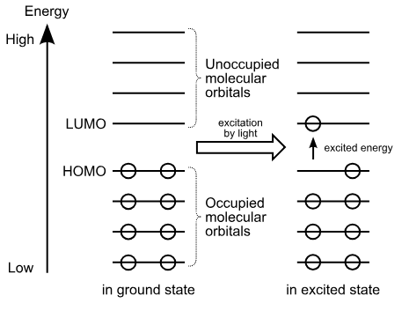
Semiconductors: Semiconductors are solids where there is only a small difference in energy. called a band gap, between the filled valence band of electrons and a conduction band.
If cooled to absolute zero, the electrons occupy their lowest possible energy levels. The conduction band is empty, and ·the material is a perfect insulator.
At normal temperatures, some electrons are thermally excited from the valency band to the conduction band, and hence' they can conduct electricity by the passage of electrons at normal temperatures.

Slide 29
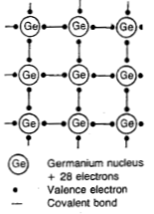
c) The conductivity is in between that of a metal and an insulator and depends on the number of electrons in the conduction band.
Germanium and silicon are the most important commercial examples of semiconductors. Atoms of Si and Ge both have four electrons in their outer shell, which form four covalent bonds to other atoms. At low temperature they do not conduct electric current.
The band gaps are only 68 kJ mol⁻¹ for Ge, and 106 kJ mol⁻¹ for Si, and at room temperature a few valence electrons gain sufficient energy from the thermal vibration of the atoms to be promoted into the conduction band.

Slide 30
If the crystal is connected in an electric circuit, these thermally excited electrons carry a small current, and make the Si or Ge crystal slightly conducting. This is termed intrinsic semiconduction. Expressed in another way, some bonds are broken, and these valence electrons can migrate; and conduct electricity.
As the temperature is increased, the conductivity increases, that is the electrical resistance decreases. Above 100°C, so many valence electrons are promoted to the conduction band in Ge that the crystal lattice disintegrates. With Si the maximum working temperature is 150°C. This intrinsic semiconduction is undesirable, and precautions must be taken to limit the working temperature of transistors.

Slide 31
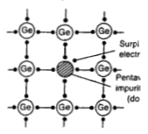
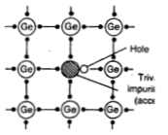
Extrinsic conduction: Pure Si and Ge can be made semiconducting in a controlled way by adding impurities which act as charge carriers. Some atoms with five outer electrons, such as arsenic As, are deliberately added to the silicon crystal. This process is called 'doping' the crystal. Only four of the outer electrons of As atom are required to form bonds in the lattice. At absolute zero or low temperatures, the fifth electron is localized on the As atom. However, at normal temperatures, some of these fifth electrons on As are excited into the conduction band, where they can carry current quite readily. This is extrinsic conduction. It increases the amount of semiconduction far above that possible by intrinsic conduction. Since the current is carried by excess electrons, it is n-type semiconduction.
Positive hole created by Indium atom with 3 electrons.
n-type semiconduction
p-type semiconduction

Slide 32
Electromagnetic Radiations
Energy can be transmitted through space by electromagnetic radiations. Some forms of radiant energy are radio waves, visible light, infrared light, ultraviolet light, X-rays and γ-radiations. Electromagnetic radiations are so named because they consist of waves which have electrical and magnetic properties.
Wavelength: The wavelength is defined as the distance between two successive crests or troughs of a wave. Wavelength is denoted by the Greek letter λ. It is expressed in centimetres or metres or in angstrom units.
Frequency: The frequency is the number of waves which pass a given point in one second. Frequency is denoted by the letter υ (nu) and is expressed in hertz (hz).

Slide 33
Speed: The speed (or velocity) of a wave is the distance through which a particular wave travels in one second. Speed is denoted by c and it is expressed in cm per second. Speed is related to frequency and wavelength by the expression c = νλ or Speed = Frequency × Wavelength
Wave Number: This is reciprocal of the wavelength and is given the symbol ν (nu bar). That is, v = 1/λ The wave number is the number of wavelengths per unit of length covered. Its units are cm⁻¹ or m⁻¹.

Slide 34
PHOTOELECTRIC EFFECT: When a beam of light of sufficiently high frequency is allowed to strike a metal surface in vacuum, electrons are ejected from the metal surface. This phenomenon is known as Photoelectric effect and the ejected electrons Photoelectrons.
With the help of this photoelectric apparatus the following observations can be made :
(1) An increase in the intensity of incident light does not increase the energy of the photoelectrons. It merely increases their rate of emission.
(2) The kinetic energy of the photoelectrons increases linearly with the frequency of the incident light. If the frequency is decreased below a certain critical value (Threshold frequency, ν0), no electrons are ejected at all.

